Slide 1


™
Investor Presentation
September 2026
1

Slide 2
Disclaimer
FORWARD-LOOKING STATEMENTS AND NON-GAAP FINANCIAL MEASURES
Some of the information in this presentation is not historical in nature and may constitute forward-looking statements, which are made pursuant to the safe harbor provisions of the Private Securities Litigation Reform Act of 1995. These statements may be identified by the use of forward-looking terminology such as “believes,” “expects,” “anticipates,” “may,” “will,” “should,” “seeks,” “approximately,” “intends,” “plans,” “estimates,” or the negative of these words or other comparable terminology. The discussion of financial trends, strategy, plans, projections or intentions may also include forward-looking statements. These forward-looking statements involve risks and uncertainties that could cause actual results to differ materially from those projected, anticipated or implied by such statements. Although it is not possible to predict or identify all such risks and uncertainties, they may include, but are not limited to, those described in the Company’s annual, quarterly and current reports (i.e., Form 10-K, Form 10-Q and Form 8-K) as filed or furnished with the Securities and Exchange Commission (SEC). You are cautioned not to place undue reliance on any such forward-looking statements, which speak only as of the date such statements were first made. To the degree financial information is included in this presentation, it is in summary form only and must be considered in the context of the full details provided in the Company’s most recent annual, quarterly or current report as filed or furnished with the SEC. The Company’s SEC reports are available at https://starlingoncology.com under the “Investor Relations” tab. Except to the extent required by law, the Company undertakes no obligation to publicly release the result of any revisions to these forward-looking statements to reflect events or circumstances after the date hereof, or to reflect the occurrence of unanticipated events.
Goals, targets, expectations and/or projections are subject to significant business, economic and competitive uncertainties and contingencies, many of which are beyond the control of the Company and its management and are based upon assumptions with respect to future decisions, which are subject to change. Actual results may vary and such variations may be material. Nothing in this should be regarded as a representation by any person that these goals, targets, expectation and/or projections will be achieved and the Company undertakes no duty to update them.
Non-GAAP Financial Measures
To supplement the Company’s financial results and guidance presented in accordance with U.S. generally accepted accounting principles (GAAP), the company uses certain non-GAAP financial measures in this presentation, including Adjusted EBITDA. The company believes that this non-GAAP financial measure provides useful supplementary information to, and facilitates additional analysis by, investors and analysts.
Unaudited Financial Information
This presentation contains unaudited financial information. The unaudited financial information has been prepared on the same basis as the Company's audited financial statements and, in the opinion of management, reflects all adjustments necessary for the fair presentation of the unaudited financial information. However, the unaudited financial information contained in this presentation is preliminary and may be subject to change. Accordingly, such financial information may be adjusted or may be presented differently in periodic reports or other filings filed by the Company with the SEC, and such differences may be material. In addition, past performance is not a guarantee or indication of future financial condition and/or results of operations and should not be relied upon for such reason.
Starling Oncology | Investor Presentation
2

Slide 3
Investment Highlights
1
A leading national oncology-focused VBC Platform
2
Large TAM, with long-term growth driven by secular trends
3
Balanced model with at-risk VBC and FFS ancillary services
4
Multiple levers for growth across a diversified business
5
Proven leadership team with deep industry experience
6
Strong recurring revenue growth and sustainable profitability
Starling Oncology | Investor Presentation
3

Slide 4














High-Quality Care Delivery & Benefits Management Platform
Care Delivery
Benefits Management Platform
Community oncologists
Delegated provider network management
Nursing & mid-level care
Utilization and case management
Infusion suites
Drug formulary
Specialty pharmacy
Claims adjudication
Radiosurgery
Clinical research
Patient call center
OUR MISSION
Uniting benefits management and direct care in one patient-first model, making value-based cancer care accessible everywhere
Starling Oncology | Investor Presentation
4

Slide 5




Starling At A Glance
SCALE & EXPERIENCE
PATIENT REACH
FINANCIAL OUTLOOK
19+ Yrs
60+
2.3M+
300K+
$650–670M
$2–7M
In Business
Payor Contracts
VBC Lives
2025 Encounters
FY26 Revenue
FY26 Adj. EBITDA
REVENUE BY SEGMENT
OPERATIONAL FOOTPRINT
+25% CAGR
Note: 2026E reflects the midpoint of FY2026 revenue guidance of $650–670M, as provided in the Company’s 2Q’26 earnings release (August 6, 2026).
Starling Oncology | Investor Presentation
5

Slide 6



Recent Announcements
Refinancing
Rebranding
Continued Growth
Portal Launch
Repaid the $86M Deerfield note through a strategic refinancing with OrbiMed, strengthening the balance sheet while expanding revolver capacity to $25M
Relaunched as Starling Oncology and began trading on Nasdaq under the new ticker STLN
Signed new delegated contracts in Nevada & Oregon and reached California exclusivity, adding ~230K capitated lives
Launching Starling Oncology Nexus™ to strengthen provider engagement and clinical pathway adherence
Jul 7, 2026
Aug 3, 2026
Aug 6, 2026
Aug 17, 2026
Starling Oncology | Investor Presentation
6

Slide 7
Oncology Care Costs Are Rising Rapidly
2.1M+
$246B
+8% y/y
New U.S. cancer diagnoses in 2026 (+25% vs. 2016)⁽¹⁾
Total U.S. cancer care cost by 2030E (+34% vs. 2015)⁽²⁾
Oncology drug spend growth, 2Q26 (Top-75, vs. +15% in 1Q26)⁽³⁾
U.S. Oncology Drug Spending, Annual ($B)⁽⁴⁾
$180B
~12% CAGR ('20–'28E)
$120B
$95B
$73B
$81B
2020
2022
2023
2024
2028E
(1) American Cancer Society. (2) National Cancer Institute. (3) Wall street research. (4) IQVIA Institute for Human Data Science.
Starling Oncology | Investor Presentation
7

Slide 8





Fee-for-Service Oncology Misaligns Incentives
U.S. ONCOLOGY SPEND
FEE-FOR-SERVICE ONCOLOGY
$99B → $180B
~80–85%⁽²⁾
1
U.S. oncology drug spending nearly doubles by 2028⁽¹⁾
of a typical FFS oncologist’s income comes from the drug spread on buy-and-bill chemotherapy
~$412K
→ Disincentivizes lower-cost, equally effective alternatives
2
Median cost of a new oncology drug in 2024⁽¹⁾
VALUE-BASED CARE
Paid by episode
“Payers are shifting infused oncology drugs from buy-and-bill toward value-based, specialty-pharmacy models”⁽¹⁾
not by drug or procedure volume
→ Providers are rewarded for choosing lower-cost, equally effective treatment
(1) IQVIA. (2) AmerisourceBergen / Oncology Supply practice benchmarking.
Starling Oncology | Investor Presentation
8

Slide 9




Starling Oncology Solutions and Scale
% OF REVENUE⁽¹⁾
Capitation
16%
Fixed per-member-per-month payments from payors to manage a population's oncology care.
29%
Fee-for-Service
Billing insurance and copay for E&M visits, infusions, drug resale, and radiosurgery services.
54%
Specialty Pharmacy
Billed to pharmacy benefit managers for specialty oral and self-injectable medications.
Clinical & Other
Clinical trial services billed to pharma sponsors, plus quality and gain-sharing incentives.
~1%
Note:
(1) Revenue mix reflects FY2025 total revenue of $503M.
Starling Oncology | Investor Presentation
9

Slide 10











National Footprint with Significant Upside
Non-CA markets are the growth engine — lives up 272% and revenue up 44% since 2024
Lives by State (Lives in thousands)
Revenue by State ($ in millions)
CA
Non-CA
▲ Non-CA +272%
CA
Non-CA
▲ +44%
White Space Within Existing Markets⁽¹⁾
STLN Penetration in California: 7.3%
STLN Penetration in Non-CA: 2.2%
Key Partners
Managed Care Organizations
Independent Physician Associations
Delegated Provider Groups
Notes:
(1) Reflect STLN’s 2025 revenue as a percent of TAM; TAM reflects Medicare Advantage, Managed Medicaid, and Commercial lives in STLN states (CA, FL, NV, AZ, OR); Assumes revenue PMPM of $50, $10 and $5 for Medicare Advantage, Managed Medicaid, and Commercial, respectively.
Source: Mark Farrah Associates.
Starling Oncology | Investor Presentation
10
Notes:
James to ask Lee for file
MA Lives – STLN MA Lives * 50 * 12
Weighted Average PMPM (50 for MA; 10 for Medicaid; 5 for Commercial); Can take total lives and subtract;
Source Mark Farrach

Slide 11




Starling’s Full-Spectrum Capitated Offering
Narrow Network Capitation
Delegation, Open-Network Capitation
VS.
Starling Oncology contracts with providers that are globally capitated with a Knox-Keene license to serves as the exclusive oncology provider.
Starling Oncology contracts with managed care providers to take full accountability for the payor’s oncology benefit, from network design through payment adjudication.
NETWORK MODEL
2025 REVENUE
NETWORK MODEL
2025 REVENUE
Exclusive
$85M
Hybrid
$11M
EXPECTED MLR¹
PMPM
EXPECTED MLR¹
PMPM
~65-70%
$Mid-single digit
~80-85%
$Mid-double digit
EXPECTED BENEFITS
EXPECTED BENEFITS
Predictable, recurring revenue
Recurring revenue with greater scalability
High margins from tightly managed populations
Greater revenue per patient through the hybrid model
FUTURE OF STARLING ONCOLOGY GROWTH
Notes:
(1) MLR is defined as payroll, third-party charges, medical supplies plus IV drug costs incurred by Starling Oncology divided by net capitation revenue.
Starling Oncology | Investor Presentation
11

Slide 12
Narrow and Delegated Patient Pathways
Step 1
Step 2
Step 3
Starling Oncology contracts with Payor to manage oncology care via:
Oncology patients seen for capitated outpatient medical oncology services in Starling Oncology or network clinic
STLN captures additional clinical revenue from services not included in capitation for outpatient medical oncology
Narrow Network
Starling Oncology Clinics
Specialty Pharmacy
Imaging
Carveout Drugs
Clinical Research
Fully Delegated
Starling Oncology Clinics
Specialty Pharmacy
Imaging
Carveout Services
Starling Oncology Network
Clinical Research
Future State: Network Services
Starling Oncology | Investor Presentation
12
Notes:
Remove limits to medical exceptions box (that was referring to leakage)
Add clinical research

Slide 13






Delegated Network Overview
Delegated Contract Ramp
Clinics Outside CA: Owned vs. Networked
Revenue
Gross Margin
Owned
Networked
Quarterly Delegated Members
Months
~70K
MONTHS 1–4
MONTHS 5–8
MONTHS 9–12
Transition of Care Period
VBC Adoption
Mature State
Starling Oncology | Investor Presentation
13

Slide 14




Specialty Pharmacy Overview
Revenue & Gross Margin
Multi-Year Growth in Script Volume
Scripts per 1K Visits & Clinic Visits
Revenue
Gross Margin
Starling Specialty Pharmacy Advantages
A convenient, affordable option for patients and network providers, while driving strong economics for Starling Oncology
Lowers patient out-of-pocket copays
~100% utilized for in-office or mail-order dispensing
Improves medication regimen adherence and compliance
Fulfills virtually all Part D scripts across the employed network
Reduces cost to payors vs. independent specialty pharmacies
Starling Oncology | Investor Presentation
14

Slide 15
The Starling Care Model
Care Navigation Program with Proven Outcomes
PROVEN IMPACT
IHI Patient Safety Organization
Accessible Community-based locations
~85%
29%
Overall MLR
Lower Inpatient Admissions
Behavioral Health Support
Comprehensive Hospital Coverage
~23%
33%
Typical Payor Savings in Year 1 of STLN Contract
Fewer ER Visits Among Newly-Diagnosed Patients
>25%
123%
Clinical Trials Providing Access for Underserved Populations
Integrated Medical and Radiation Oncology
Lower Median Total Healthcare Costs for Patients
Improved Patient Satisfaction with Overall Health
35%
33%
Improvement in Patient Satisfaction
Fewer ER Visits Among Newly-Diagnosed Patients
Outpatient blood product transfusions
Internationally-recognized Physicians
Internal Second-Opinion Network
3 of 4
4.6 / 5
CMS MIPS Quality Measures — Outperforms Avg. Provider
Patient Satisfaction Rating
Notes: (1) Based on study on STLN patient population conducted by researchers at Stanford University in collaboration with the American Society of Clinical Oncology, and published in the Journal of Oncology Practice in September 2019 titled “Lay Health Worker-Led Cancer Symptom Screening Intervention and the Effect on Patient-Reported Satisfaction, Health Status, Health Care Use, and Total Costs: Results from a Tri-Part Collaboration.” (2) Average weighted payor savings for new STLN capitation contracts signed 2024 and 2025. (3) Average patient rating across >3,500 Google Reviews; also comparable to 90.7 Press Ganey score for 2024.
Starling Oncology | Investor Presentation
15

Slide 16

Powered by Starling Oncology Nexus™
KEY PLATFORM CAPABILITIES
The Command Center
for Value-Based Care
Automated pathway compliance checking against continuously updated evidence-based guidelines.
Starling's proprietary platform serves as the operational backbone for utilization management, unifying clinical pathways, real-time analytics, and collaborative decision-making in a single comprehensive system.
Real-time drug waste identification with actionable recommendations.
Seamless peer-to-peer consultation scheduling and documentation.
Comprehensive audit trails and reporting for quality assurance.
Intake for practice data that is rich in clinical insights.
Clinician engagement with ancillary services such as pharmacy
By centralizing the entire UM workflow, Starling Oncology Nexus™ ensures that >95% of order requests receive same-day approval, driving physician engagement and clinical appropriateness, along with >98% adherence to Starling’s value-based formulary.
Starling Oncology | Investor Presentation
16

Slide 17





Strong NCCN Adherence Through Starling Oncology Nexus™
300+
>98%
>95%
Network providers on Nexus and Growing
Adherence to Starling value-based formulary
Orders receiving same-day decision
>27%
>41%
Reduction in Cost per Cancer Episode Post-delegation
Reduction in Cost per IV Visit Post-delegation
Data post-effective date of all Delegated Capitation Contracts at Starling as of August 2026
Starling Oncology | Investor Presentation
17

Slide 18


What Sets Starling Apart in a Competitive Landscape
Care Delivery Model
Provide Clinical Care
Utilization Management
Incentivized to Keep Drug Costs Low
Purchasing Drugs at Scale
Care Navigation Model
Utilization Management Only
Subsidiary of a Distributor
Independent Provider
Starling Oncology | Investor Presentation
18

Slide 19




Growth Strategy
™
Strategic M&A
Add Ancillary Services
Enter New Markets
Add New Customers and Deepen Relationships with Existing Customers
New Lives Drives Growth
Starling Oncology | Investor Presentation
19

Slide 20


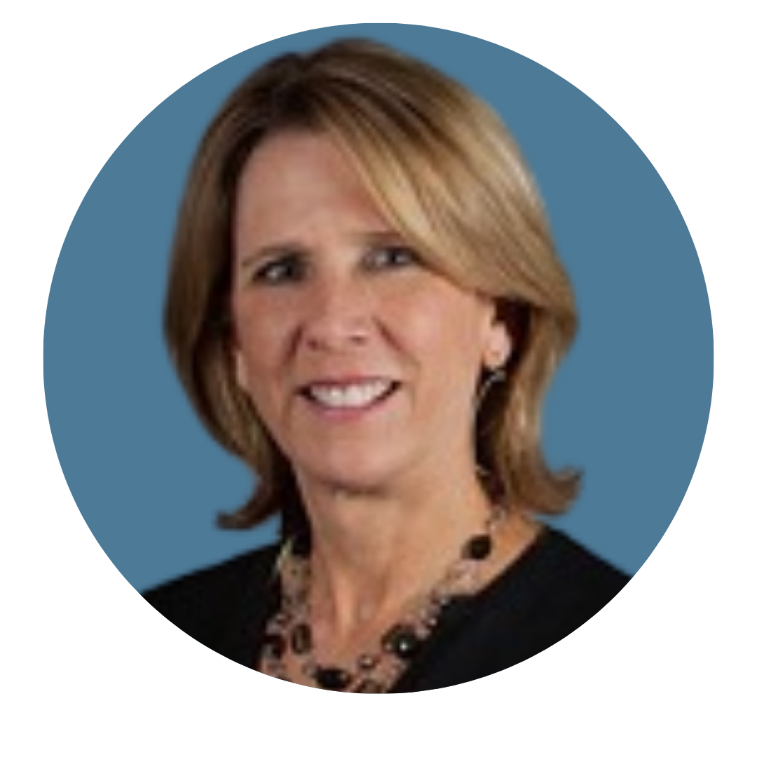

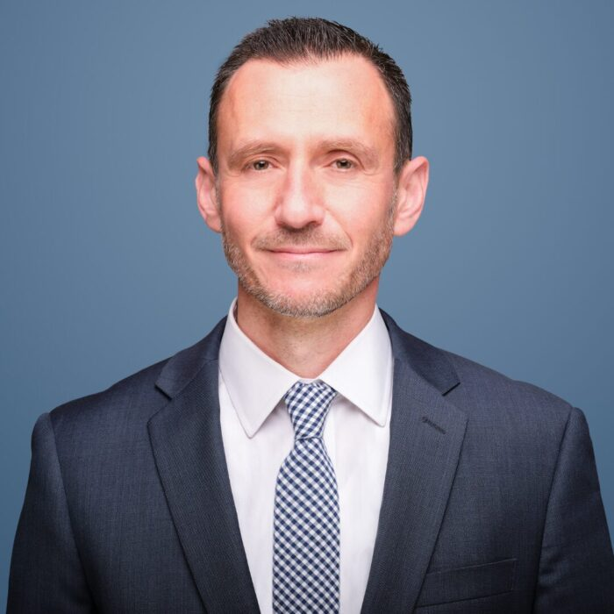












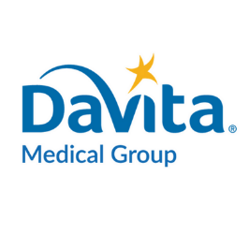











Strong Leadership with Deep Industry Experience
Jordan McInerney
Chief Development Officer
Jeffrey Langsam, DO
Chief Clinical Officer
=
=
Prior Experience
Prior Experience
Daniel Virnich, MD
Chief Executive Officer
Rob Carter
Chief Financial Officer
Anne McGeorge
Chairperson of the Board
=
Joined STLN in 2020 as COO, CEO since 2023
20+ years of executive leadership and value-based care operations experience
Previously, served as President of DaVita Medical Group, Florida and Senior VP of Operations for Healthcare Partners in Southern California
Joined STLN in 2021 as VP of Finance, CFO since 2024
15+ years of finance leadership experience in healthcare focused on FP&A and analytics
Previously, served as Head of FP&A at Hoag Health System and held several FP&A leadership roles at SCAN Health Plan and McKesson
Joined STLN Board in 2021, Chairman since August 2025
35+ years of experience providing strategic and operational guidance to healthcare organizations
Has served as Operating Partner of Havencrest Healthcare since 2018 and previously served as Managing Partner of Grant Thornton
Yale D. Podnos, MD
Chief Medical Officer
Kristin England
Chief Administrative Officer
=
=
Prior Experience
Prior Experience
Prior Experience
Prior Experience
Prior Experience
Stephen Cella
SVP, Finance
Rakesh Panda
Chief Information Officer
=
=
Prior Experience
Prior Experience
Starling Oncology | Investor Presentation
20

Slide 21

Financial Overview
Starling Oncology | Investor Presentation
21

Slide 22







Financial Highlights
1
2
3
Diversified Revenue Base
Recurring, Visible Revenue
Direct Cost Control
Revenue spans capitation, fee-for-service, specialty pharmacy, and clinical solutions, reducing reliance on any single payer model
Multi-year capitation contracts and recurring treatment cycles create subscription-like visibility into future revenue
Full control over oncology drug purchasing, formulary design, and treatment regimens protects margins as drug costs rise
4
5
6
Durable Growth
Path to Profitability
Strengthening Debt Structure
Fueled by long-term oncology cost inflation and rising patient volumes as the population ages
On track for positive Adjusted EBITDA in 2026, driven by scale, cost discipline, and an improving payer mix
Refinanced legacy debt via strategic partnership with OrbiMed, improving terms and extending runway
Starling Oncology | Investor Presentation
22

Slide 23
Consistent Revenue Growth
Revenue ($M)
Patient Lives (000s)
Adjusted EBITDA ($M)
$660M
$4.5
+27% Rev. CAGR
$503M
$393M
$324M
($12.4)
($25.8)
($35.7)
2023
2024
2025
2026E
2023
2024
2025
2023
2024
2025
2026E
Capitated Revenue
FFS Revenue
Specialty Pharmacy
Clinical Trials & Other
Notes: ​
(1) 2026E figures represent the midpoint of 2026 Guidance. Adjusted EBITDA is a non-GAAP measure. Please see the appendix for a reconciliation to the nearest GAAP measure.
Starling Oncology | Investor Presentation
23

Slide 24
2Q26 Quarterly Results
Revenue
Patient Lives
Adjusted EBITDA⁽¹⁾
2Q26 Operational Highlights
($ in millions)
(000’s)
($ in millions)
Adjusted EBITDA turned positive at $0.2M, a $4.3M improvement Y/Y
+13.7%
35% YoY
Achieved California exclusivity with a top partner, adding ~230K capitated lives
Specialty Pharmacy revenue up 58% Y/Y to $98.6M on record Part D fills
SG&A improved to 18.6% of revenue, down from 22.5% in the prior-year quarter
Launching Starling Oncology Nexus provider portal in mid-August to deepen provider engagement
2Q25
2Q26
Notes: ​
(1) Adjusted EBITDA is a non-GAAP measure. A reconciliation to the nearest GAAP measure is available upon request.
Starling Oncology | Investor Presentation
24

Slide 25




Proven Ability to Maintain Stable MLR at Scale
Consistent MLR Performance Despite Elevated Industry Utilization
MLR Levers
Cap Revenue ($M) ⁽¹⁾
MLR ⁽¹⁾⁽²⁾
Industry-Leading Utilization Management
Proprietary platform manages cost of care in real time
Launched Delegated contract and began on-boarding those patients
76%
85%
69%
72%
68%
68%
Scaled Drug Procurement
Drives margin on risk encounters; Part D adds stability
61%
$26.9
$28.0
$20.4
$23.2
$17.0
$17.0
$18.5
Hybrid Care Delivery Model
Differentiated engagement and ancillary services via STLN’s network
Starling Oncology Nexus™
Drives clinical pathway adherence across the network
MLR expected in 80–90% range over next 12mo as delegated lives ramp, normalizing to 75–85% at run-rate
Notes:
(1) Excludes gain share contract revenue.
(2) MLR is defined as payroll, third-party charges, medical supplies plus IV drug costs incurred by STLN divided by net capitation revenue.
Starling Oncology | Investor Presentation
25

Slide 26
Path to Breakeven and Future Profitability Levers
SG&A Declining as a Percentage of Revenue, Gross Margins Trending Higher
Adj EBITDA
Margin Levers
($ in millions)
Gross Margin
Leverage existing clinical labor
Drive Specialty Pharmacy, Clinical Research, and behavioral attachment
Drug procurement, Pathways, and buy-ins
Adj EBITDA Margin
Leverage existing corporate and field infrastructure
AI efficiencies
Vendor diversification
Notes: ​
(1) Adjusted EBITDA is a non-GAAP measure. A reconciliation to the nearest GAAP measure is available upon request.
Starling Oncology | Investor Presentation
26

Slide 27
Longer Term Guidance
FY2025
FY2026
2028 TARGETS
REVENUE
REVENUE
REVENUE GROWTH
$502.7M
$650–$670M +31% mid.
~20%
(Raised from $630–$650)¹
GROSS PROFIT
GROSS PROFIT
REVENUE CAGR THROUGH 2028
$76.4M
$105–$110M +41% mid.
BUSINESS MIX
(Raised from $97–$107)¹
Capitation ~30% / Dispensary ~50% of total revenue
ADJUSTED EBITDA
ADJUSTED EBITDA
$(12.4)M
$2–$7M TURNS +
(Raised from $0–$9)¹
MARGIN EXPANSION
FREE CASH FLOW
FREE CASH FLOW
Adjusted EBITDA margin scales to mid-single digits of revenue
$(23.9)M
$5–$15M TURNS +
(Unchanged)
(1) Guidance raises reflect updates provided as of the Company’s 2Q’26 earnings release, August 6, 2026.
Starling Oncology | Investor Presentation
27

Slide 28
Investment Highlights
1
A leading national oncology-focused VBC Platform
2
Large TAM, with long-term growth driven by secular trends
3
Balanced model with at-risk VBC and FFS ancillary services
4
Multiple levers for growth across a diversified business
5
Proven leadership team with deep industry experience
6
Strong recurring revenue growth and sustainable profitability
Starling Oncology | Investor Presentation
28

